Slide 1


Climate risk & disaster Management

Slide 2

Learning Objectives
Our goal is to predict risk of climate change
And predict effect of natural disaster
GOAL
Source :
www.freepik.com/

Slide 3
Tools and Technology used
Python: Google colab ,jupyter notebook
Google Search engine
Exploratory data analysis
Numpy,pandas,seaborn,matplotlib etc.

Slide 4
Methodology
First we cleaned the data and explore data of the file ,
Then we used machine learning algo .
For example exploratory data analysis

Slide 5
Problem Statement:
Climate change has intensified the frequency and severity of natural disasters such as floods, cyclones, droughts, and heatwaves. These events disrupt lives, damage critical infrastructure, and threaten food, water, and energy security. The absence of robust risk assessment, early warning systems, and effective disaster management strategies leaves vulnerable communities exposed to severe losses. There is an urgent need for integrated, technology-driven, and sustainable approaches to anticipate, mitigate, and manage climate-related risks.

Slide 6
Solution:
Implementing a comprehensive Climate Risk and Disaster Management framework requires:
Early Warning Systems powered by AI, IoT, and satellite data for timely alerts.
Risk Assessment & Mapping to identify vulnerable regions and populations.
Resilient Infrastructure built to withstand extreme weather events.
Community Awareness & Training to enhance preparedness and response capacity.
Policy Integration & Collaboration among governments, NGOs, and private sectors for coordinated action.

Slide 7
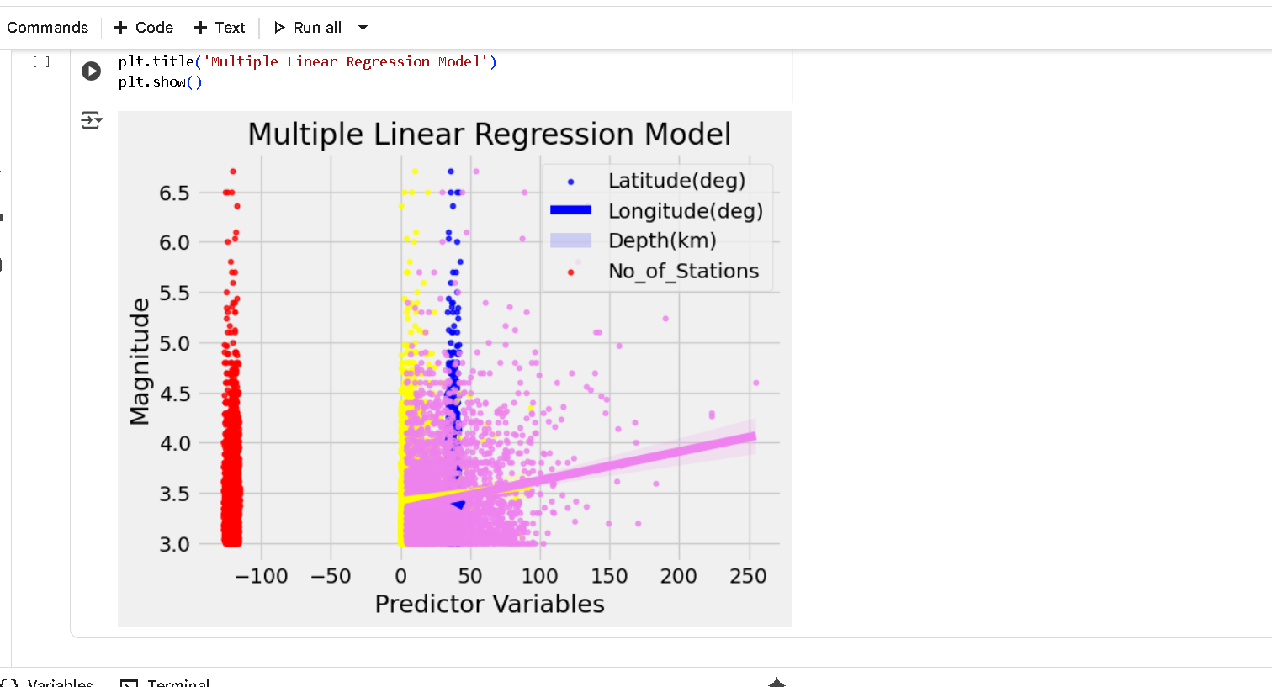
Screenshot of Output:

Slide 8
Conclusion:
Climate change poses unavoidable risks, but with proactive planning and effective disaster management, the impact can be significantly reduced. By combining technology, policy, and community participation, societies can build resilience against future climate challenges. Sustainable development and preparedness are not just options—they are essential for protecting lives, resources, and the environment.

